Slide 1
Making Every Contact Count
Signposting
Information & Resources
Created by Voluntary Action Harrow
(All information correct at time of publishing this Directory of Services cards: April (2025)

Slide 2
Contents
1. Health and Wellbeing Services (Green)
Focus: Physical, mental, and emotional health support.
5 Ways to Mental Wellbeing
Bereavement Care Services
Cancer Screening & Support
Dementia & Support
Diabetes Support
Early Help Support
Fall Prevention Advice & Support
Feeling Unwell?
General Wellbeing Harrow Healthy Walks
Hypertension Info & Support
Mental Health Support Mind

Slide 3
Contents
Cont'd: Health and Wellbeing Services (Green)
Focus: Physical, mental, and emotional health support.
Oral Health Team
Perimenopause / Menopause
Safer Sleep
Sexual Health Appointments
Sexual Health Services
Single Point of Access Mental Health
Smoking Support Services
Substance Misuse Over 18's
Substance Misuse Under 18's
Vaccinations
Weight Management Support

Slide 4
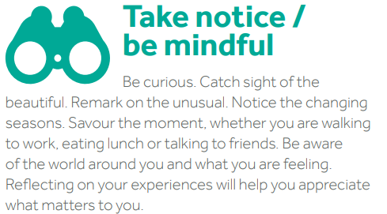
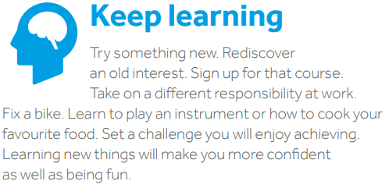
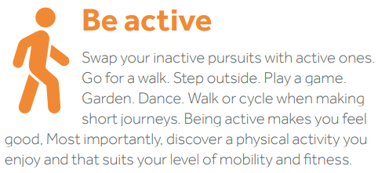
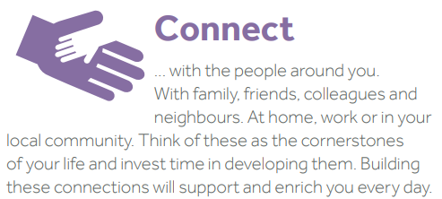
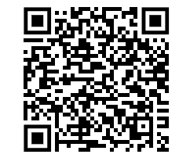
The 5 ways to wellbeing
https://www.harrow.gov.uk/adult-social-care/mental-health

Slide 5
Bereavement Support Service
Bereavement is a personal experience. It can often affect people in different ways. Sometimes it can be hard to see these feelings in ourselves.
Grief is not always felt as sadness and loneliness. It may feel like a general feeling of discomfort and things ‘not being right’.
Grieving takes time. Sometimes the grief can be overwhelming over a long period of time. It can be necessary to have specialist support.
Are you grieving the loss of a dear family member
or friend? It may be helpful to talk to someone
about how you are feeling.
Please contact us: We offer a FREE service and we are here to listen.
Telephone: 020 8427 5720
Office opening hours: Monday, Wednesday and Thursday 8.00am – 3.00pm

Slide 6
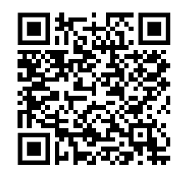
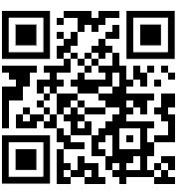
Cancer Screening & Support
Bowel Cancer Screening:
How do I get a screening kit?
Bowel cancer screening is offered to everyone aged 54 to 74 every 2 years. It will soon be available for everyone aged 50 to 74 years old, so you may be sent a home test kit now if you’re aged 50 or over. This is because your risk of getting bowel cancer gets higher as you get older.
You can also get screening for bowel cancer every 2 years if you are aged 75 or over, but you need to call the bowel cancer screening helpline on 0800 707 6060 and ask for the test.
Breast Cancer Screening:
The National Breast Screening Programme was introduced in 1988 as an early detection service for
breast cancer. It states that all women who are aged between 50 – 70 years of age will be routinely
invited for free breast screening every three years. The programme is very successful and currently
saves around 1,400 lives per year.
Cervical Cancer Screening: or smear test, is a method of detecting abnormal (pre-cancerous) cells in the cervix in order to prevent cervical cancer. The cervix is the entrance to the womb from the vagina. Cervical screening is recommended every three years for women aged 25 to 49 and every five years for women aged 50 to 64 or more frequently if smear results indicates abnormal changes.
Cancer Info Harrow Booklet: https://healthyharrow.org.uk/publichealth/
Macmillan Cancer support: Have questions about cancer?
Phone: 0808 808 000
Website: Macmillan Cancer Support

Slide 7
Dementia
Dementia is not only about memory loss. It can also affect the way you speak, think, feel and behave. It's also important to remember that dementia is not a natural part of ageing.
Dementia is a syndrome (a group of related symptoms) associated with an ongoing decline of brain functioning. There are many different causes of dementia, and many different types.
People often get confused about the difference between Alzheimer's disease and dementia. Alzheimer's disease is a type of dementia and, together with vascular dementia, makes up the majority of cases.

Slide 8
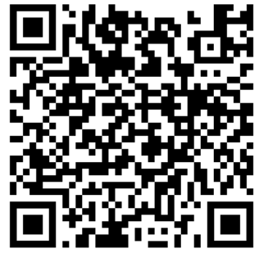
How Common is Dementia
Research shows there are more than 944,000 people in the UK who have dementia. 1 in 11 people over the age of 65 have dementia in the UK.
The number of people with dementia is increasing because people are living longer. It is estimated that by 2030, the number of people with dementia in the UK will be more than 1 million.
Further information:
Living well with dementia
Staying independent with dementia
Looking after someone with dementia
Sign up for Dementia Information Service emails

Slide 9
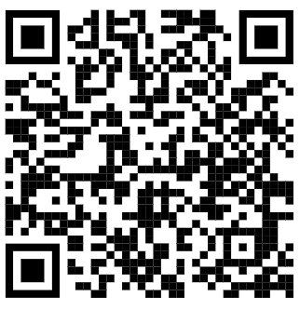
What is Diabetes?
Diabetes is a serious condition where your blood glucose level is too high. It can happen when your body doesn't produce enough insulin or the insulin it produces isn't effective. Or, when your body can't produce any insulin at all.
Symptoms of Diabetes
The symptoms can depend on the type of diabetes you have. But the common symptoms of diabetes include:
Going to the toilet a lot, especially at night
Being really thirsty
Feeling more tired than usual
Losing weight without trying to
Genital itching or thrush
Cuts and wounds take longer to heal
Blurred vision
Know Diabetes webpage: www.knowdiabetes.org.uk

Slide 10
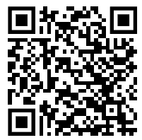
Early Help Support Services 0 – 25 years
The Early Support Team delivers services Harrow Activities for:
parents
carers
pregnant women
young people aged 0-19 (or 25 with Special Educational Needs or Disability)
Cedars Children's Centre
Telephone: 020 8736 6222
Hillview Children’s Centre
Telephone: 020 8422 4692
Families Information Services: Telephone: 020 8901 2690
Email: fis@harrow.gov.uk
Family Resource Directory
Families Information Service

Slide 11
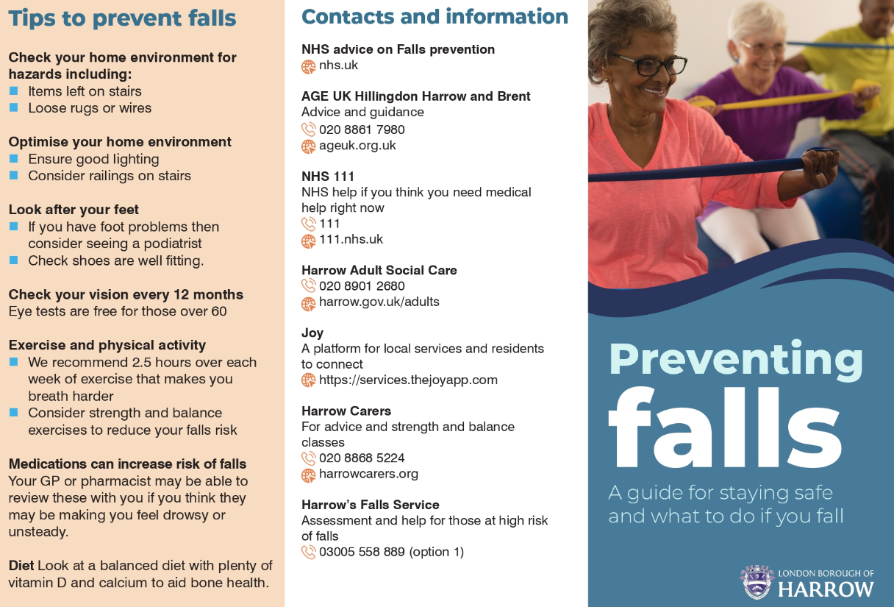

Slide 12
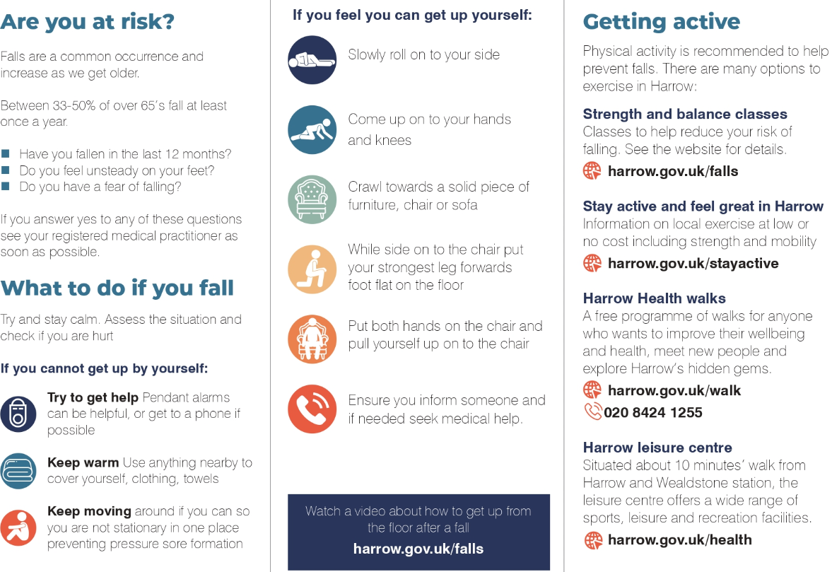

Slide 13
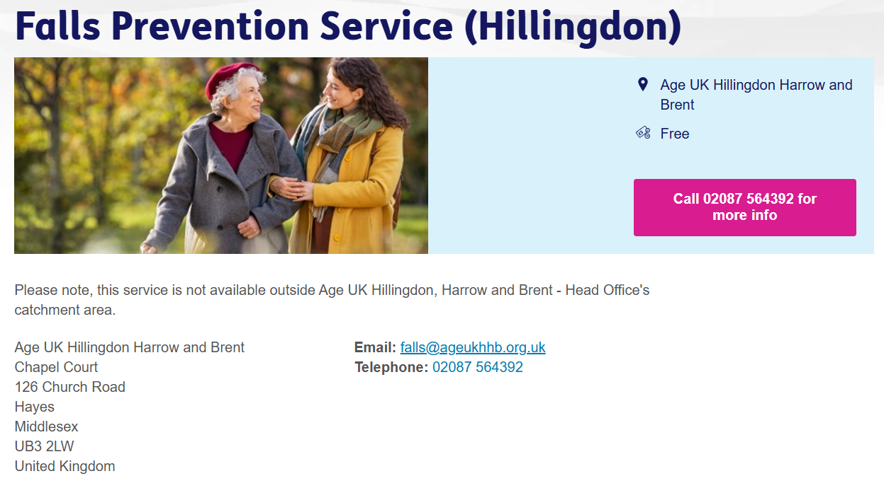

Slide 14
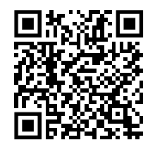
Falls Prevention
For individuals aged 65 and over who have had a fall, near miss or ongoing fear of falling that affects daily activities.
Watford FC’s Community Sports and Education Trust are delivering FREE strength and balance exercise classes in Harrow. These sessions are run by qualified instructors to improve peoples’ balance and strength, as well as their physical and mental wellbeing. All exercises are tailored to reduce the risk of falls.
For more information or to book please contact Shona McHale on 07510 593 192 or email fallsprevention@watfordfc.com
Click here to complete our form and register your interest
If you would like an accessible registration form, please contact Shona.

Slide 15
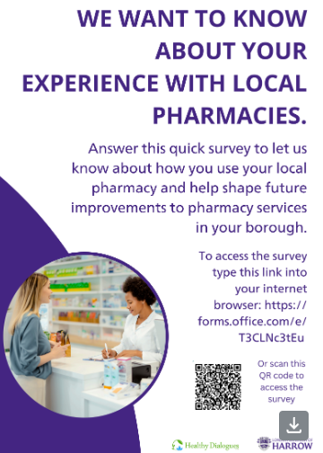
Feeling Unwell?

Slide 16
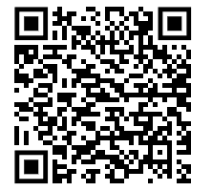
Feeling Unwell?
When to use NHS 111 online or call 111
NHS 111 can help if you think you need medical help right now. You can get help from NHS 111:
by using 111 online
in the NHS App
by calling 111
111 can direct you to the best place to get help if you cannot contact your GP during the day, or when your GP is closed (out-of-hours).
Depending on what you need, you might be advised to:
call 999 or go to A&E in an emergency
go to an urgent treatment centre
see an evening and weekend GP (out-of-hours GP)
book a callback from a nurse
get urgent specialist support, for dental or mental health problems
contact your own GP surgery
see a pharmacist for help with a minor illness
look after yourself safely at home

Slide 17
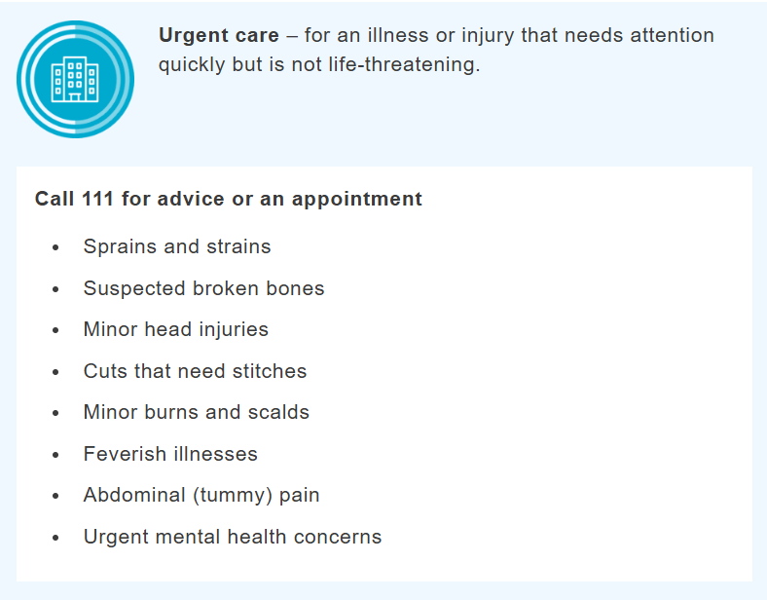
What is the difference between urgent and emergency healthcare?
Urgent care:
Is for an illness or injury that needs attention quickly but is not a life-threatening situation. Although some urgent care is provided in hospitals, much is also provided by services outside hospital.

Slide 18
What happens when you call 999
The call handler will ask you some questions. They will want to know things like:
the location of the emergency (for example, the postcode or any landmarks)
what has happened (the main symptom or reason for the call)
your contact number (in case they need to call you back)
They will tell you when they have all the information they need.
If you are told you will get a callback, make sure there is someone there to answer.
Information:
Calling 999 does not always mean an ambulance will be sent.
You might be told it's safe for you to make your own way to A&E, or to be seen elsewhere.

Slide 19
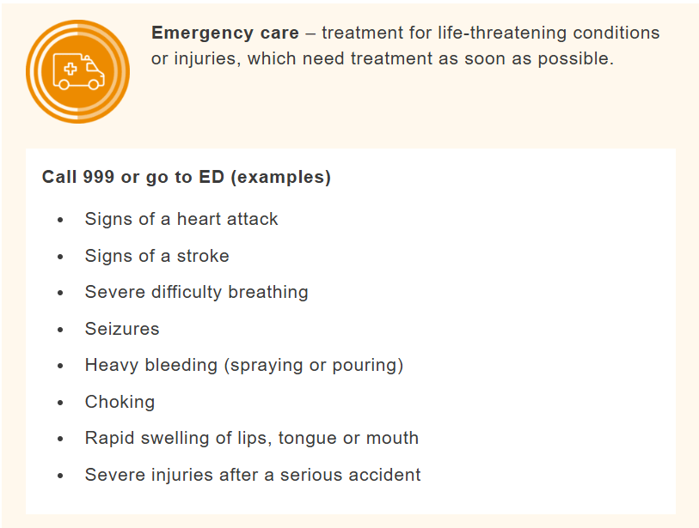
What is the difference between urgent and emergency healthcare?
A & E - Emergency Care:
This is help for life-threatening conditions. If someone is in immediate danger because of an injury or a severe health problem, they need emergency care quickly. This is available at emergency departments (EDs), also known as Accident and Emergency (A&E) or casualty.
The role of EDs: EDs have specialist staff and equipment to handle serious health emergencies. However, with rising demands, EDs are becoming very busy.

Slide 20
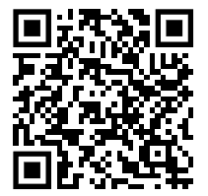
General Mental Health & Wellbeing
Harrow Health Walks
Free, leader-led walks for all ages and fitness levels.
No booking required; runs daily across the borough.
Contact: 020 8424 1255 | publichealth@harrow.gov.uk | Details

Slide 21
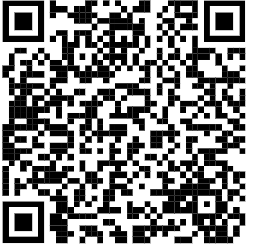
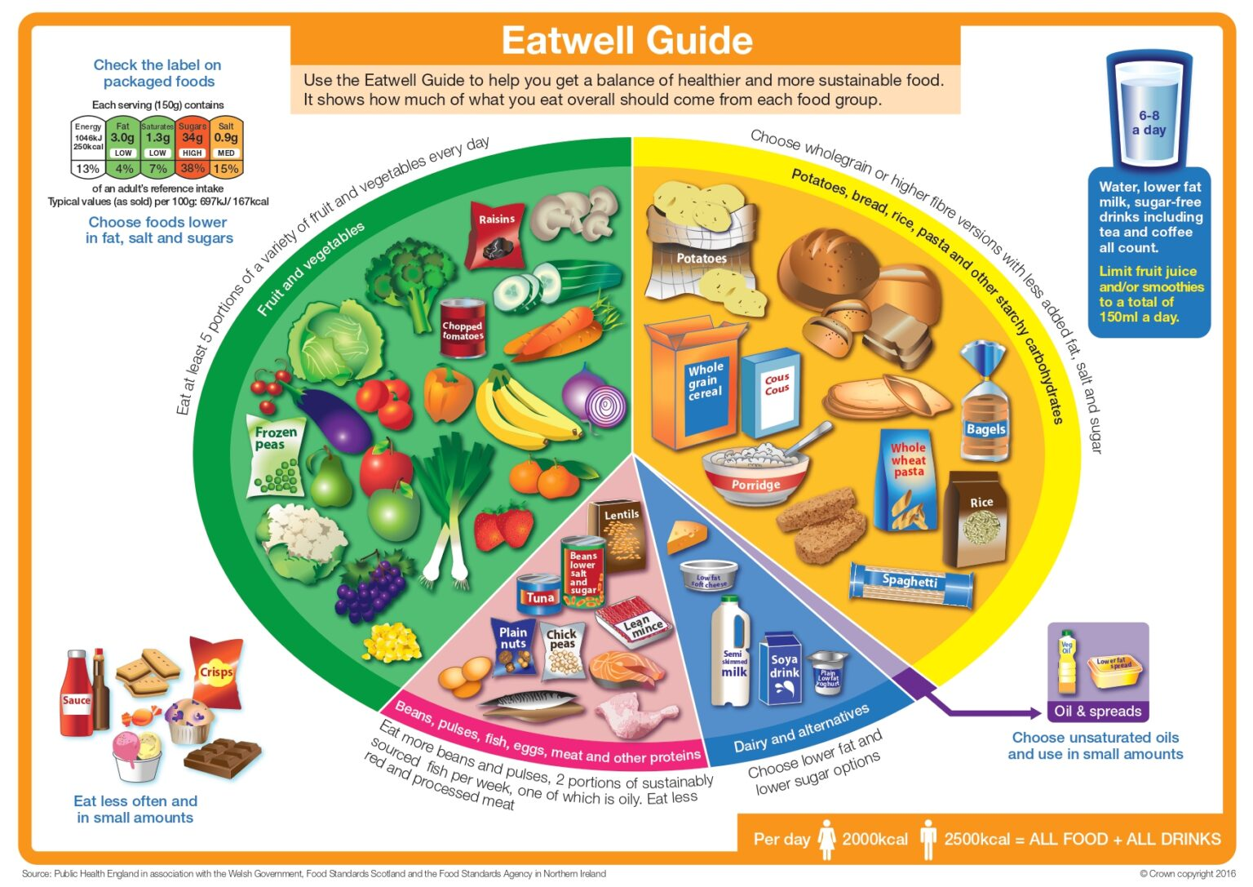
Hypertension
High blood pressure can often be prevented or reduced by eating healthily, maintaining a healthy weight, taking regular exercise, drinking alcohol in moderation and not smoking.
The Eatwell Guide highlights the different types of food that make up our diet, and shows the proportions we should eat them in to have a well-balanced and healthy diet. Salt raises your blood pressure. The more salt you eat, the higher your blood pressure. Aim to eat less than 6g (0.2oz) of salt a day, which is about a teaspoonful. Eating a low-fat diet that includes lots of fibre, such as wholegrain rice, bread and pasta, and plenty of fruit and vegetables also helps lower blood pressure.
Having too much salt can cause high blood pressure.

Slide 22
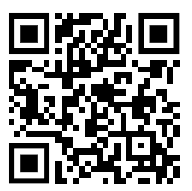

Slide 23
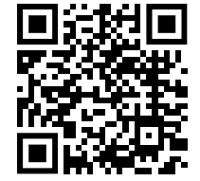
Harrow Oral Health Promotion Team
Oral Health Promotion Team for the Borough of Harrow aims to ensure that every child in living Harrow is given the best start in life and the opportunity to grow up free from dental decay.
Harrow has the highest rates of decay in children and now falls at the top above all other London Boroughs. This data highlighted that 42.4% of 5 year olds living in Harrow have dental decay.
For more information

Slide 24
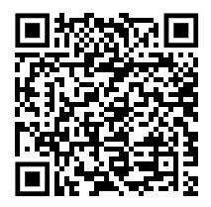
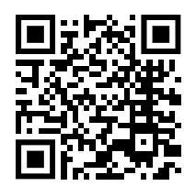
Tooth Decay & How to Brush Your Teeth
You can start brushing your baby's teeth as soon as they start to come through. Use a baby toothbrush
with a tiny smear of fluoride toothpaste.
Take your child with you when you go for your own dental appointments so they get used to the idea.
NHS dental treatment for children is free, but not all dentists will take on new NHS patients.
To find a dentist, you can use our services search, ask at your local clinic, or contact NHS England on 0300 311 22 3 or email england.contactus@nhs.net.
Use your postcode to find a dentist:

Slide 25
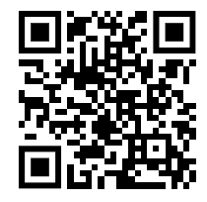
Perimenopause
Perimenopause is when you have symptoms of menopause but your periods have not stopped. Perimenopause ends and you reach menopause when you have not had a period for 12 months.
To find out more about the signs and indicators
of Perimenopause please use the QR code
To read the booklet about menopause see web link to PDF below:
https://menopausesupport.co.uk/wp-content/uploads/2023/10/Understanding-Menopause-booklet-poster-replaced-Oct-23-1-scaled.jpg

Slide 26
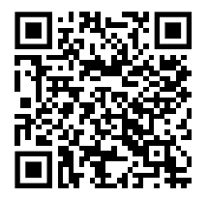
Menopause
Menopause is when your periods stop due to lower hormone levels. It usually affects women between the ages of 45 and 55, but it can happen earlier.
It affects anyone who has periods.
Menopause can happen naturally, or for reasons such as surgery to remove the ovaries (oophorectomy) or the uterus (hysterectomy), cancer treatments like chemotherapy, or a genetic reason. Sometimes the reason is unknown.
Menopause and perimenopause symptoms can have a big impact on your life, including relationships and work.
For support & help please scan the QR code

Slide 27
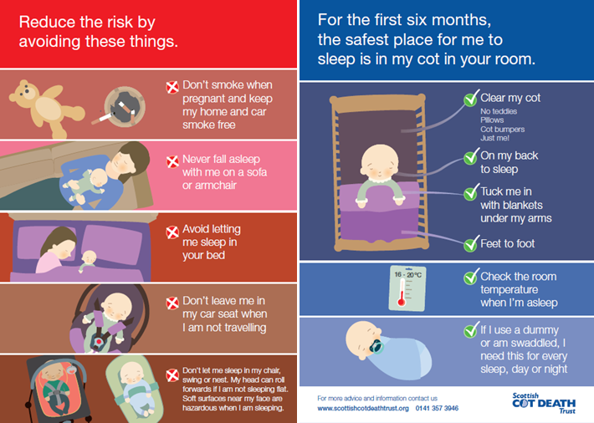
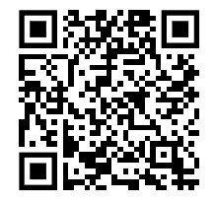
Safe Sleep
For the first 6 months of your baby’s life the safest place for them to sleep is in a cot in the same room as the person looking after them, for all sleeps.
Sadly, every year a small number of babies die suddenly and unexpectedly in their sleep. Sometimes a cause is found, such as an underlying health condition, but often there’s no obvious reason.
Visit the Lullaby Trust :

Slide 28
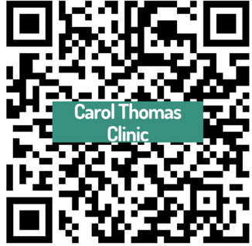
Sexual Health Support & Services
Sexual Health Clinics
Caryl Thomas Clinic Harrow
A guide to sexual Health Services (NHS)
Sexual Assault & Rape Support services

Slide 29
Sexual Health Appointments
Call 020 3893 8575 or email LNWH-tr.HarrowISRH@nhs.net
Please note sexual health appointments are available Monday to Friday, 9am to 4.30pm.
Lines open
Monday: 8.30am to 5.30pm
Tuesday: 8.30am to 5.30pm
Wednesday: 8.30am to 7pm
Thursday: 8.30am to 7pm
Friday: 9am to 4.30pm
Saturday: Closed
Sunday: Closed

Slide 30
HIV Support Services

Slide 31
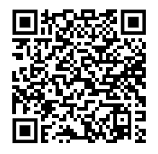
Single Point of Access
The Single Point of Access is open 24 hours a day, seven days a week, 365 days a year. You can call us on 0800 0234 650 or email cnw-tr.spa@nhs.net
The Single Point of Access provides one number and one email address for referrals to secondary mental health services and support in a mental health crisis in the Boroughs of Brent, Harrow, Hillingdon, Kensington & Chelsea and Westminster, and also Milton Keynes (out of hours).
You can also call NHS 111 and select the mental health option if you are experiencing something that makes you feel unsafe, distressed, or worried about your mental health. This is an additional way to contact crisis services and does not replace the Trust’s Mental Health Crisis Line.
You can read more about NHS 111 on this page
Watch the VAH video

Slide 32
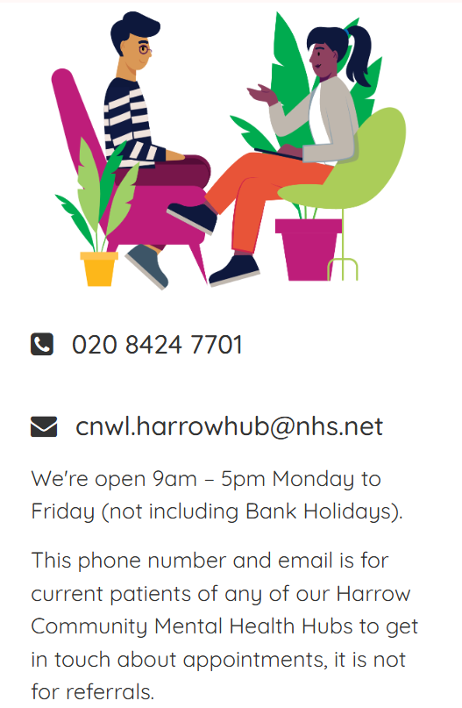
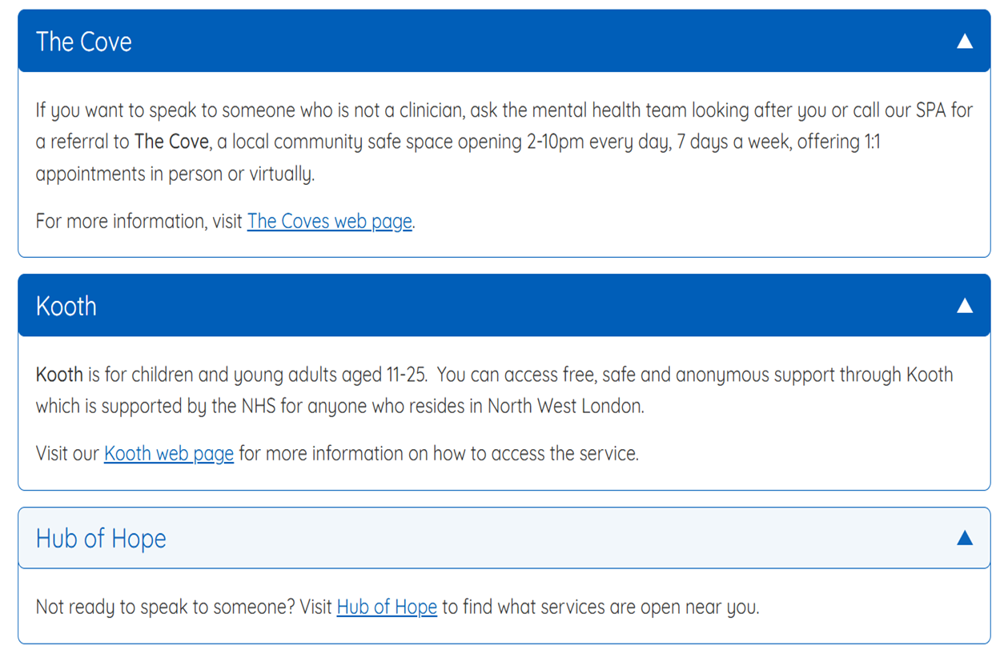
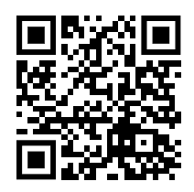
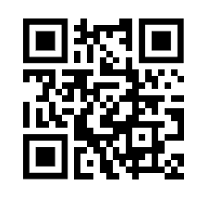
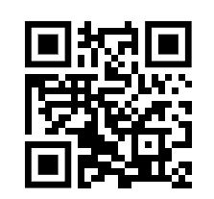

Slide 33
Smoking Support Services
Access one to one specialist advice for quitting smoking for good. Speak to a smokefree advisor by calling 0300 123 1044. Speak to your GP to get support in quitting.

Slide 34
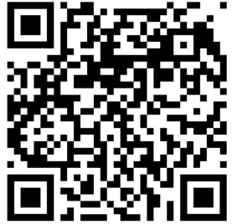
Substance Misuse Service
Young People (Under 18s)
Compass provides a free and confidential service.
It's for children, young people and families who need help with their own or another's drug or alcohol use. People under 18 years can self-refer or be referred. They can then support them up to the age of 24.
Find further details on the Compass website

Slide 35
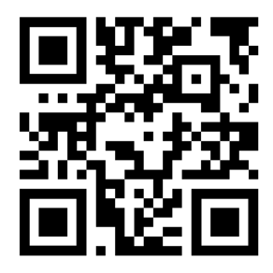
Substance Misuse Service
Substance Misuse Service Adults (Over 18s)
The adult substance misuse service is delivered by Via. It is for Harrow residents, aged over 18, their families and carers. They focus on recovery.
Services available include:
drug and alcohol testing
clinic based and outreach work - providing screening and assessment
aftercare skills for life, providing education, training and employment
prescribing medicine to assist recovery
dual diagnosis counselling and consumption service
supervised by a pharmacy
criminal justice and psychosocial interventions - hospital
liaison service
VIA also provide training and support to for professionals.
Visit www.viaorg.uk

Slide 36
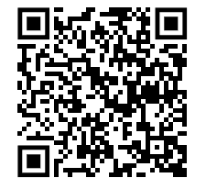
Vaccinations
Winter vaccinations
The following vaccinations are offered to people who are higher risk of developing more severe symptoms and complications including pneumonia and hospitalisation.
Flu
It is recommended to get the flu vaccination every year. This includes adults aged 65 and over, younger adults with certain medical conditions (such as lung conditions), pregnant women, primary school children and carers.
COVID-19
This is offered if you are pregnant, aged 65 and over, a younger adult with higher risk of complications because of a health condition or treatment, or a care home resident.
Your GP will likely contact you to arrange the above vaccinations. You could get a letter, text, phone call or email. However, if you know you are due for a vaccination, you can speak to your GP surgery to book the appointment.
To find out where you can get your vaccine use the QR code:

Slide 37
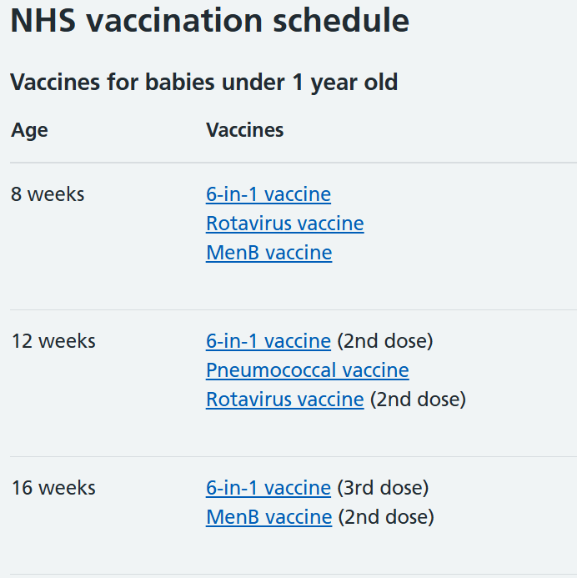
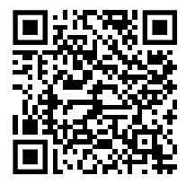
Child Vaccinations
It is important that vaccines are given on time for the best protection, but if you or your child missed a vaccine, contact your GP to catch up.

Slide 38
Adult Vaccinations
Adults
The following vaccinations are offered to adults who are at higher risk of complications.
Shingles
You are eligible for the shingles vaccine when you turn 65. You will be offered 2 doses of the vaccine which are given between 6 and 12 months apart.
Pneumococcal
The pneumococcal vaccine helps protect against serious illnesses like pneumonia and meningitis. The risk of serious infection and hospitalisation increases with age. It is therefore recommended to have one dose of vaccine at the age of 65.

Slide 39
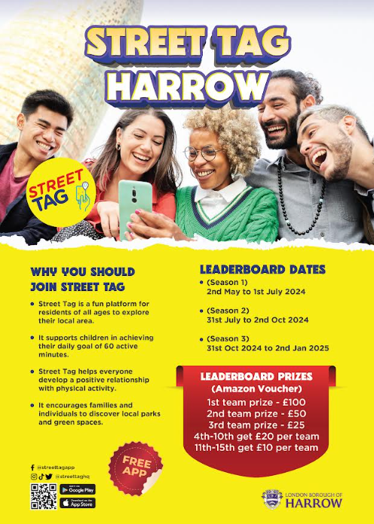
Exercise & weight Management through fun Activities

Slide 40
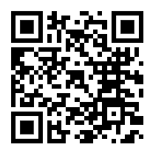
Harrow Cycle Hub
Want to Learn to Ride?
Harrow Cycle Hub has friendly cycling classes for teenagers and adults, taught by qualified volunteer coaches at Harrow Civic Centre. No bike? No problem! Bike hire is available.
New Courses now available in April and May:
Learn to Ride and Confidence Builder - sign up on This Link
Concerned about the cost? Read our Hardship Policy Information

Slide 41
Harrow Cycle Hub
GRAND DAY OUT - CANONS PARK PICNIC 25 MAY
Sunday 25 May is the London Festival of Cycling;
we’re celebrating with a picnic in beautiful Canons Park!
Volunteers are leading rides from all over Harrow and beyond, to meet at 12 for a picnic. Book on these links and pack a picnic! Keep checking back for more rides.
HARROW RECREATION GROUND - MIXED RIDE WITH KEVIN AND KEVIN
HEADSTONE MANOR PARK - WOMEN’S RIDE WITH DINAH AND JULIE
PINNER - MIXED RIDE WITH VERONICA AND CHRIS
STANMORE - WOMEN’S RIDE WITH JACKIE AND SHAMA
WEST HARROW PARK - WOMEN’S RIDE WITH DELANI AND ELLIE

Slide 42
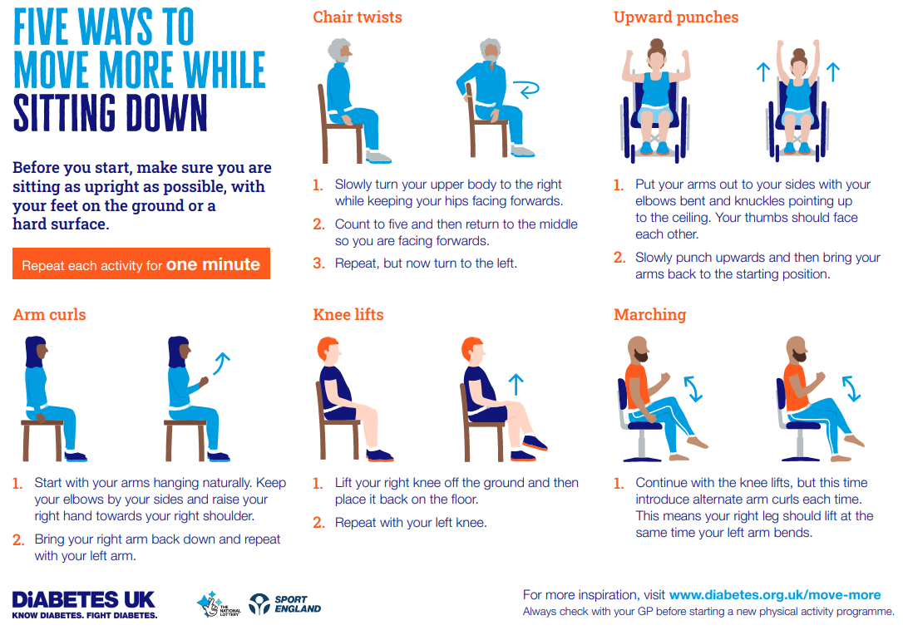

Slide 44
Contents
2. Disability and Accessibility Support (Blue)
Focus: Support for individuals with disabilities or special needs.
ADHD & Autism Support for Adults Community
Disability Hate Crime
Harrow Association of Disabled People (HAD)
Harrow Carers and Care Assessments
Optivita Early Years & Men's Support

Slide 45
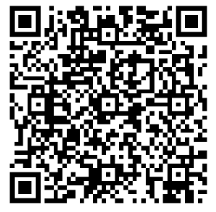
ADHD & Autism Support for Adults in Harrow
Centre for ADHD & Autism support sessions
They provide information, training, support groups and practical help to residents of North-West London. Their support services encompass education, benefits, parenting and care advice with signposting to other agencies if appropriate. They also offer specialised parenting courses, workshops and training.
Should you live outside of these areas and need
support, please see the ADHD Foundation for
advice on ADHD and the National Autistic Society for
information on autism.
Notes:
Taking on a caring role can mean facing a life of poverty, isolation, frustration, ill health and depression. Many carers go unidentified until many years into their caring role and the majority struggle alone unaware that help is available to them. Families affected by illness or disability are facing tough times at the moment and it has never been more important that they know their rights.

Slide 46
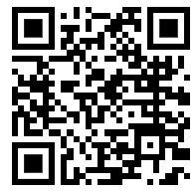
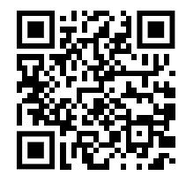
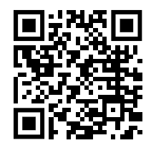
Community
Best Beginnings - Baby Buddy App
Multi-award-winning app supporting families’ mental and physical health.
Integrates with Harrow's maternity and early years pathways. Learn More
Home-Start Barnet, Brent & Harrow - Dad Matters
Supporting male parents in the First 1001 Days with attachment, bonding, and mental health.
Contact: admin@homestartbarnet.org | Website
HASVO
Empowering Somali and Arab communities with culturally tailored workshops and videos.
Focus: Immunisation, prenatal/postnatal health, and reducing health inequalities.
Contact: info@hasvo.org | Website

Slide 47
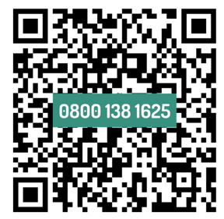
Disability Hate Crime
We are committed to supporting the disabled community in fighting against all types of disability hate.
In 2021/2022, over 14,242 disability hate crimes were reported to the police across England and Wales.
How Stop Hate UK support people affected by hate against the disabled community:
A huge part of our work is to deal directly with victims of
Hate Crime and to help them cope with the incident and
navigate their options.
Visit the website for details online Reporting Form is here

Slide 48
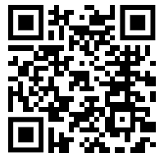
Harrow Association of Disabled People (HAD)
Ensuring that Disabled people have access to relevant information, advice and support from HAD.
Delivering high quality services that empower and enable disabled people to have the freedom of choice, access their rights to live independently and gain equality.
Providing a channel and voice for Disabled people to campaign on the issues they identify as important.
Influencing and assisting wider society to remove all physical and attitudinal barriers that cause exclusion and disadvantage to Disabled people.
Be pro-active in bringing for consultation, to Disabled people’s attention,
any issues which may affect them in the future.
Address: The Wealdstone Centre, 38-40 High Street, Wealdstone, HA3 7AE
Telephone: 020 8861 9920 Email: General@HAD.org.uk

Slide 49
Carers
A carer can be a child or an adult who provides support to family or friends who could not manage without this help. This could be caring for:
a relative,
Partner or friend who is ill, frail, disabled or has mental ill-health or substance misuse problems. All the care they give is unpaid.
How do you identify a carer?
Many carers juggle their caring responsibilities with work, study and other family commitments. Some, in particular younger carers, are not known to be carers or may not see themselves as carers.
Carer's Assessment: Local authorities have a duty to offer a carer's assessment to individuals providing care. These assessments help identify carers and assess their needs. If you are a carer, you can request a carer's assessment from your local authority.
Notes:
Taking on a caring role can mean facing a life of poverty, isolation, frustration, ill health and depression. Many carers go unidentified until many years into their caring role and the majority struggle alone unaware that help is available to them. Families affected by illness or disability are facing tough times at the moment and it has never been more important that they know their rights.
One of the main obstacles to carers getting the right support is identification – both self-identification and identification by health professionals. Encouraging services to think carer, think family, can help to improve the identification of carers and support better health and wellbeing outcomes.
They don’t tell relatives, friends or health and care professionals about their responsibilities because of a fear of separation, guilt, pride or other reasons.

Slide 50
Carers
Harrow Carers - Harrow Carers is an independent charity and voluntary organisation is the focal point for carers in Harrow to obtain information and advice.
Self-referral - 020 868 5224 / admin@harrowcarers.org
Any practice staff can make a referral by email / phone / website online form https://harrowcarers.org
Carers Guide Book - Guide for Carers in Harrow (harrowcarers.org) - has information and a range of resources for carers including a wide range of organisations who can be of use for Carers.
Harrow Council - Carers Conversation Approach - Council staff will have ‘conversations’ with you, to best understand what is happening for you in your caring role and how it is impacting on your own health and wellbeing.
contact: 020 8901 2680 or email AHadults@harrow.gov.uk
or via www.harrow.gov.uk / carers@harrow.gov.uk for information and advice
IDENTIFY REGISTER SIGNPOST
Notes:
Taking on a caring role can mean facing a life of poverty, isolation, frustration, ill health and depression. Many carers go unidentified until many years into their caring role and the majority struggle alone unaware that help is available to them. Families affected by illness or disability are facing tough times at the moment and it has never been more important that they know their rights.

Slide 51
Optivita Early Years
Optivita Early Years is a new and innovative pilot which will deliver services to families in the South Harrow area. The NHS England-funded pilot will focus on improving life chances for parents and babies who are living in some of the most disadvantaged areas of the borough by delivering a set of interventions in early life that can prevent the escalation of complex needs, reduce inequalities in access, and improve outcomes for children under five. With a focus on prevention and health promotion as early as possible, the project aims to target support for families with children under five to improve health and wellbeing in later years.
Ignite Youth - GLOW Up! Young Mums’ Fitness Café
Weekly term-time sessions (2 hours) for mums aged 13 - 25
Activities include:
GLOW Up! Cafe: A space for healthy snacks, resources, and maternal confidence-building.
Fitness Club: Zumba classes with a qualified instructor to enhance physical fitness and social skills.
Mentoring: 1:1 sessions for emotional well-being and life skills.
Families in Action Together (Wealdstone Baby Bank)
Addressing gaps in healthcare and education access.
Activities include hosting professionals and tailored workshops for parents.
Contact: w.babybank@gmail.com | Facebook

Slide 52
Men’s Mental Health Initiatives
(for dad's as well as the dad's group in Optivita)
Mind in Harrow Men’s Social and Support Group
Weekly meetings (Tuesdays) at Mind in Harrow office.
Includes soup lunch and refreshments.
The Man Down Project
Combating toxic masculinity through talks, walks, and creative arts.
Registration: Link or email: themandownproject@gmail.com.

Slide 54
Contents
3. Housing and Environmental Issues (Yellow)
Focus: Housing conditions, safety, and environmental concerns.
Condensation, Damp & Mould
Damp, Mould & Housing Support
Find a Warm Space (Community Hubs)
Homelessness & Resources (Support for Asylum Seekers)
How to Keep Warm at Night
How to Keep Warm in Winter
How to Keep Your Home Warm
Staying Cool in Summer
Warm Hubs Harrow (Community Hubs)

Slide 55
Condensation, Damp and Mould
Condensation, damp and mould can have a serious effect on people’s health, especially if they have respiratory illnesses, allergies and asthma.
Damp can be caused by condensation (from cooking, bathing, drying wet clothes) or by issues such as leaks or blocked gutters. Damp can lead to mould growth. Problems with damp and mould should be reported to the landlord (private, housing association or council). If the landlord does not address the issue, contact Harrow Council Environmental Health using the webform: www.harrow.gov.uk/housing-property/report-issue-privately-rented-accommodation
Harrow Council tenants should report concerns with damp and mould online at
www.harrow.gov.uk/housing-property/request-repair-council-home
by phone 020 8901 2630
Do you have an issue with your rental home you’d like to discuss? Contact: jacksoncaines@harrowlawcentre.org.uk
Notes:
Every person across this country deserves to live in a home that is safe, warm and dry.
The tragic death of 2-year-old Awaab Ishak in 2020, due to mould in his family home, should never happen to another family.
The Coroner’s report into Awaab’s death describes a catalogue of failures, and a housing provider that abdicated its responsibilities to his family and hid behind legal processes.
This guidance is a direct response to the Coroner’s report, and has been developed with a multidisciplinary group of experts in housing and health. Members of the government’s expert Committee on the Medical Effects of Air Pollutants were also consulted. It makes sure that social and private sector landlords have a thorough understanding of their legal responsibilities, and of the serious health risks that damp and mould pose.
Landlords must ensure that the accommodation they provide is free from serious hazards, including damp and mould, and that homes are fit for habitation. They must treat cases of damp and mould with the utmost seriousness and act promptly to protect their tenants’ health.
As this guidance also makes clear, tenants should not be blamed for damp and mould. Damp and mould in the home are not the result of ‘lifestyle choices’, and it is the responsibility of landlords to identify and address the underlying causes of the problem, such as structural issues or inadequate ventilation.
The tragic death of Awaab Ishak should never have happened. His family’s complaints about their living conditions were repeatedly ignored - an experience that is familiar to many tenants.

Slide 56
Damp, Mould & Housing Support
Harrow Law Centre can provide advice in the following areas:
Possession and eviction
Homelessness
Unlawful evictions
Disrepair cases, where there is a serious risk of harm to the health and safety of the individual or member of the individual’s household.
Most of our housing work is funded by the Legal Aid Agency. We will assess whether you are financially eligible for legal aid and also whether your case is in scope for legal aid.
If you require housing advice, please contact us by email or calling us on 020 8863 4355 and select option 1.
Do you have an issue with your rental home you would like to discuss? Contact: jacksoncaines@harrowlawcentre.org.uk
Notes:
Every person across this country deserves to live in a home that is safe, warm and dry.
The tragic death of 2-year-old Awaab Ishak in 2020, due to mould in his family home, should never happen to another family.
The Coroner’s report into Awaab’s death describes a catalogue of failures, and a housing provider that abdicated its responsibilities to his family and hid behind legal processes.
This guidance is a direct response to the Coroner’s report, and has been developed with a multidisciplinary group of experts in housing and health. Members of the government’s expert Committee on the Medical Effects of Air Pollutants were also consulted. It makes sure that social and private sector landlords have a thorough understanding of their legal responsibilities, and of the serious health risks that damp and mould pose.
Landlords must ensure that the accommodation they provide is free from serious hazards, including damp and mould, and that homes are fit for habitation. They must treat cases of damp and mould with the utmost seriousness and act promptly to protect their tenants’ health.
As this guidance also makes clear, tenants should not be blamed for damp and mould. Damp and mould in the home are not the result of ‘lifestyle choices’, and it is the responsibility of landlords to identify and address the underlying causes of the problem, such as structural issues or inadequate ventilation.
The tragic death of Awaab Ishak should never have happened. His family’s complaints about their living conditions were repeatedly ignored - an experience that is familiar to many tenants.

Slide 57
Find a Warm Space
As temperatures plummet, many organisations across the country are creating warm hubs. These spaces offer warm food and drink, heating and a place to meet others.
Warm Welcome has 3,000 registered hubs across the UK, offering welcoming spaces to the public. You can find one near you, here.
Many local organisations such as churches, town halls, shops, pubs and cafes are also offering warm hubs. Check with your local council to find a space near you.
Harrow Community/Warm Hubs link is here

Slide 58
Preventing Homelessness
London is in a severe housing affordability crisis due to the cost of living and changes to the Private Rented Sector (PRS).
Difficult to find affordable larger accommodation locally, especially for families who need help from HB/UC for housing costs and/or are affected by the Benefit Cap.
Harrow has a small social housing stock. Housing solutions will usually be in the private rented sector. It is difficult to find alternative accommodation in Harrow, so it is really important to try to avoid losing your current home.
Get advice early on if you think you may need to move.
If you are at risk of losing your home use the online webform https://www.harrow.gov.uk/wf_housingadvice or call Housing Advice on 020 8424 1093 (option 1).
Notes:
The best way to tackle homelessness is to stop it happening in the first place. To do so is both cost effective and humane.
The concept of homelessness prevention is well developed across Great Britain, but gaps still exist that stop some people getting the help they need, when they need it most.
Prevention services must be available to everybody at immediate risk of homelessness. And the on-going failure of state institutions to prevent people falling into homelessness when discharged from their care must be addressed.

Slide 60
﻿
﻿

Slide 61
What Support is Available for Asylum Seekers?
Under Asylum Support (Section 95):
Temperatures Accommodation and financial assistance for asylum seekers without means.
Local Charities & Support Groups:
British Red Cross, and Refugee Council.
NHS Healthcare:
Free primary healthcare and urgent secondary care.
Education & Legal Aid:
Free schooling for children and access to legal aid for asylum applications.
Under Destitution Support:
Section 4 support for refused asylum seekers with no other options.
Refugee Action:
www.refugee-action.org.uk

Slide 62
How to Keep Warm at Night
Staying warm at night
Temperatures plummet when it gets dark, so in winter it's important to know how to keep your bedroom as warm as possible at night. As with any room, exclude any draughts, close the windows when it's cold, and put down rugs to insulate the floor.
Bedding: Staying warm in bed is vital for us all in winter. Use extra blankets, or buy flannel or fleece bedding if you can. These materials are the warmest bedding options, as they trap body heat and are better insulators than cotton. Using thicker tog duvets will also provide additional warmth.
Electric or weighted blankets: An electric blanket is a lot cheaper to run than a heater and provides a constant source of heat throughout the night. Weighted blankets are also very comforting and help you stay warm as they don't let chilly air into the bed.
Toasty pyjamas: Wearing warm clothes in winter isn't just for daytime. At night, wearing fleece or flannel pyjamas will go a long way to keeping you warm as they trap the heat. Don't forget your feet either. Bed socks will keep your feet warm and help you sleep.
Hot water bottle: Cost effective and long lasting, a hot water bottle will provide a safe source of warmth throughout the night.
Information taken from British Red Cross website

Slide 63
How to Keep Warm in Winter
Keep your feet and hands warm
They might not be the first thing you think of, but if you want to stay nice and toasty this winter, it's important you know how to keep your feet and hands warm.
When it gets cold, your body works harder to keep blood flowing to your core and vital organs to keep them warm. This can change the blood flow to your hands and feet, meaning they may get cold. Keeping your fingers and toes snug can help regulate your body temperature, so make sure not to ignore them.
How to keep your feet warm
Wearing thick socks and slippers when indoors will help trap the heat and keep your feet toasty. If you're outside, wear warm socks and shoes that are completely waterproof.
How to keep your hands warm
Wearing gloves made of insulating materials, like wool or leather, will help keep your hands warm. You can also use winter warmer packs like hand warmers. These work best when tucked into gloves or clothing.
Information taken from British Red Cross website

Slide 64
How to Keep Warm in Winter
Keep your body warm
Extremely cold weather can have a negative impact on our health. People with respiratory problems such as asthma, or heart conditions are at particular risk during the winter months. Our bodies need to be kept at a core body temperature of 37C to stay healthy, which means rooms should be heated to a minimum of 18C.
There are many ways you can maintain your core body temperature and stay warm in winter, without turning the central heating on.
Try these tips:
Layer up your warmest indoor clothing
Wearing lots of layers rather than one thick piece of clothing will help trap your body heat and keep you warmer. Clothes made with insulating material, like wool jumpers and thermal underwear, are best for keeping you warm at home. Using a hot water bottle is also an inexpensive way to stay warmer for longer. You can also keep your feet warm with thick socks and slippers.
Food and drink
Eating healthily and drinking plenty of hot drinks throughout the day will help with staying warm at home. Avoid alcohol - it prevents your blood vessels from constricting and you'll begin to lose body heat.
Move around
It's also important to avoid sitting still for long periods of time - move around and keep as active as possible. This will help boost your circulation and keep you warm.
Information taken from British Red Cross website

Slide 65
How to Keep your Home Warm
Keep your house warm
Heating one room during the day is a cost-effective way to keep your house warm and your energy bill down. Here are a few ways to keep a room warm without using central heating.
Curtains
Open your curtains during the day - the sun still provides warmth, even in the winter months. Make sure you close them as soon as the sun sets to keep the warm air in. Investing in thicker curtains, or thermal curtain liners, will help keep the cold air out and prevent heat loss.
Use a draught excluder
We tend to lose a lot of heat through gaps around windows and doors. Exclude draughts by lining your windows with rubber seals and use a homemade draught excluder by doors - this could even be an old towel, tightly rolled.
Move furniture away from external walls
Sitting with your back against an internal wall will instantly feel a lot warmer.
Insulate your floor with rugs
If you don't have carpets, put down plenty of rugs. Hardwood or laminate floors are a lot colder than carpeted areas.
Avoid condensation on windows
With the windows closed, condensation can quickly build and can eventually turn to mould. This can be harmful to your lungs. Make sure you turn extractor fans on in the bathroom and kitchen and wipe down windows at regular intervals.
Information taken from British Red Cross website

Slide 66
Staying Cool in Summer
Turn off electrical items
Appliances generate a lot of heat, so turning them off when not in use can help keep rooms from feeling too humid. Consider visiting an air-conditioned building such as a shopping centre or public library.
Limit hot activities
Ovens and cookers emit a lot of heat, so try sticking to cold foods like sandwiches and salads, especially during the hottest times of the day.
Wear Loose clothing
Keep cool: use air conditioning or a fan, wear light and loose-fitting clothing, and keep skin wet, using a spray bottle or damp sponge and by taking cool showers.

Slide 67
Staying Cool in Summer
Stay hydrated
Drink plenty of cool fluids and water and eat cold foods with high water content like salads and fruit. Sweating causes you to lose body fluids, so staying hydrated is key to staying cool.
Take cool baths or showers
The CDC recommends taking a cool bath or shower to prevent heat-related illnesses, injury, or death. You can also cool off by chilling in a lake, pool, or ocean, but be sure to wear waterproof SPF.
Block the heat
Close curtains in rooms that face the sun, and open windows if the air outside is cooler than the air inside. You can also try sprinkling water over your skin or clothing, or keeping a damp cloth on the back of your neck.
Notes:
Centre for Dieses control and prevention

Slide 68
Warm Hubs
Community/Warm Hubs are safe places giving residents a friendly and inclusive welcome.
People can come along on their own, or with a friend, and talk to others over a hot drink.
Find Warm Hubs in Harrow
Link to Harrow Council cost of living page Energy saving
Help to get food on Harrow Council webpage
Support for Children and young people Harrow Council Webpage
Debit Advice on Harrow Council Website
www.harrowgiving.org.uk/warmhubs/

Slide 69
Contents
4. Domestic and Community Safety (Red)
Focus: Addressing abuse, safety, and community wellbeing
Domestic Abuse Support Services Info
Fire Safety
Safe Havens in Harrow

Slide 72
Domestic Abuse
Harrow domestic violence support agencies
Domestic Abuse Support Service: Cranstoun For IDVA and Floating
Support email: harrowdass@cranstoun.org.uk
Victim Support Harrow: 080 8168 9111
Harrow Safeguarding Adults Service: 020 8420 9453
Out of Hours for Safeguarding Children or Adults: 020 8424 0999
Harrow Citizens Advice Bureau: 020 8427 9477
EACH: Domestic Abuse Counselling: 0208 427 5188
WISH: Counselling and support for Young People: 020 8416 7277
Jewish Women's Aid: 0808 801 0500
Resourceful Women's Network (Harrow)

Slide 73
Domestic Abuse
Other Specialist Support Services
Forced Marriage Unit: 020 7008 0151
RESPECT - support for Male Survivors: 0845 802 4040
The Female Genital Mutilation Helpline (NSPCC): 0800 028 3550
Asian Women's Resource Centre: 0208 961 6549/5701. Or
email: info@asianwomencentre.org.uk
DAWN - an organisation that supports communities around Harrow

Slide 74
Home Fire Safety Harrow
Home Fire Safety Checker: Harrow Fire Brigade:
Get tailored advice for your home or for someone you care for.
Common Causes of fire include but are not limited to:
Cigarette
Candles
Vapes
Plug in Air Fresheners
Electric Circuit overload
Electrical Appliances
Electric Blankets
Gas
Harrow Council leaflet with info is
Available in this QR code

Slide 75
Safe Havens in Harrow
Safe Havens offer temporary refuge to people who are at risk or vulnerable. It’s a sanctuary within the community for people to get help and support their onward journey. The scheme is primarily aimed at women and girls, although these locations are open to anyone who feels harassed, vulnerable, or threatened.
Staff across the 14 locations have undergone bespoke training with the Safer Business Network, a crime reduction agency, who we are working with as part of the Council’s work to improve feelings of safety and end violence against women and girls.
The locations (which include cafés, Harrow libraries, fire stations and more) will welcome individuals requesting help and offer a secure environment until they feel ready to move on.
Each location will display a sticker on their window
confirming it is part of the scheme.

Slide 76
Contents
5. Financial and Resource Support (Orange)
Focus: Financial assistance, cost-of-living help, and food resources.
Baby Banks
Benefits Calculators
Cost of Living and Energy Efficiency
Food Banks
Gas/Electric Grants
Gas/Electric Priority Services Register
Healthy Start Scheme
Water Bills and Support
Where to Get Debt Advice

Slide 77
Baby Banks
Supporting families in need in Harrow and surrounding areas with baby essentials and pre-loved items for children aged 0-5 years.
Cariad Baby Bank
King's Church Harrow
Brigade House, Brigade Close, HA2 0LQ Email: cariadbabybank@gmail.com
Referral Website link
Wealdstone Baby Bank
Wealdstone Methodist Church
Locket Rd, Harrow, HA3 7ND, Harrow, United Kingdom
Telephone: 07727 687328
Email: w.babybank@gmail.com

Slide 79
Cost of Living
Household Support Fund
The Council's Household Support Fund may be able to help through:
Help Harrow: Access to food supplies as well as advice on energy, health,
wellbeing and benefits
Application Scheme: One-off payments that qualifying households can apply for
Vouchers for Low-income Households: The council will contact eligible households who will be sent a voucher
Free School Meals during the Holidays: Vouchers will be given to vulnerable households
Find out more about the Household Support Fund
If you receive benefits, you may automatically get Cost of Living Support Payments from the Department of Work and Pensions.

Slide 80
Foodbanks
Help Harrow
Help Harrow provides residents with access to food supplies, energy, health, wellbeing and benefits. Help Harrow allows residents in need of food to make food requests online.
This winter, Help Harrow will also be opening ‘Warm hubs’ across the borough. Help Harrow will also distribute ‘Winter Warmth Packs’ to residents who may be struggling with their energy bills. To find out more visit HelpHarrow.org
London Community Kitchen
You can visit the London Community Kitchen market every Friday 3pm to 6pm.
In Harrow you can access surplus food for free at:
The Kind Café (next to Harrow Leisure Centre) The Bridge, Christchurch Ave, Harrow, HA3 5BD
Website: LondonsCommunityKitchen.com / Email: Office@Londonscommunitykitchen.com
Romanian Food Hub
The Romanian Food Hub provides families and vulnerable adults weekly access to
non-perishable food. They also link users to services offered by local authorities and other
organisations. Visit Romanian Culture and Charity Together (rcct.uk)
Breaking Bread Trust
Support for the local community, including food help. Visit BreakingBreadTrust.org

Slide 81
Foodbanks
Helping Hands
Help and support for vulnerable and elderly residents, including food help.
Visit Helping Hands
My Yard
Supporting people facing food poverty to have access to a healthy diet and enjoy life. Focus on Grange Farm Estate in South Harrow, with other projects in other areas.
Visit MyYard.org.uk
The Basheri Project
Support for Afghan residents in Harrow, run by Masa Restaurant. For details email: management@masarestaurant.co.uk
Harrow Food Bank
Part of a nationwide network of foodbanks, supported by The Trussell Trust. The food bank works using a voucher referral system. You will need a voucher issued by a local agency to access food at the food bank, such as Citizens Advice Harrow or your Health Visitor. There is a limit on the number of times you can be given a voucher.
Visit Harrow.Foodbank.org.uk
If you already have a voucher, View the locations and opening times of Harrow Food Banks

Slide 87
Contents
6. Energy-Saving and Sustainability (Purple)
Focus: Green initiatives and sustainability efforts.
Energy Saving Changes at Home
Energy Saving Support Green Doctors
Sustain IT

Slide 88
You can save energy by making small changes to your home and habits, which can have a big impact in saving you money and your carbon footprint.
Here are some changes you can make without spending a penny:
Close your curtains at dusk to stop heat escaping. Make sure that your curtains don't block radiators as this will stop heat flowing into the room.
Don't leave appliances on stand-by.
Turning your thermostat down by 1 °C can cut your bills by up to 10%. Rooms temperatures should be around 18 °C, except the living room that should be set at 21 °C. For vulnerable people and small children keep room temperatures at 21 °C.
Switch off lights when you leave a room. Energy saving bulbs can save you up to £8 per year per bulb compared to traditional ones. Residents in receipt of benefits can receive two free bulbs from the council.
Wash your clothes at 30 °C instead of 40 °C. This uses a third less electricity.
Only boil the amount of water that you need when using the kettle.
Check to see if you are eligible to receive a grant for your home.

Slide 90
Sustain IT
Voluntary Action Harrow
Our mission for Sustain IT is to bridge the digital divide by providing access to technology for local charities and voluntary organizations. The refurbished laptops are distributed to these groups, empowering them to better serve their communities and reach their goals. Through this initiative, we help reduce electronic waste, foster sustainability, and enable others to thrive with the tools they need for success.
At Harrow Sustain IT, we work hand-in-hand with the local community to give unused laptops a second life. We collect donated laptops, keyboards, mice, and cables from individuals and regularly gather laptops from the Harrow Recycling Centre. These donations are then cleaned, repaired, and tested by our team of dedicated volunteers to ensure they are in working order.
For more information sustainit@vah.org.uk

Slide 91
Contents
7. Information and Training Resources (Pink)
Focus: Information directories, training, and additional resources.
Additional Resources
Contact for MECC Training
Harrow Support Directories
MECC London Link

Slide 92
9. Additional Resources
Live Well - NHS (www.nhs.uk) | Advice and guidance around a wide range of health related topics including diet, exercise, smoking and alcohol use
How Are You? quiz - NHS (www.nhs.uk) | free 10 minute quiz creating a personalised health score with dashboard of where you can improve
Mental health and wellbeing – Harrow Council | Site with advice and extensive local resources for mental health in the locality
Better Health - NHS (www.nhs.uk) | Healthy changes start with little changes. Whether you want to lose weight, get active or quit smoking, Better Health is here with lots of free tools and support
Citizens Advice Harrow | Provide free, confidential and impartial advice and campaign on big issues affecting people's lives, online or telephone options available
Joy - The right support is just a few clicks away (thejoyapp.com) | New digital platform JOY that is being used by PCNs to help with non-clinical referrals. It serves as a directory of community services for the public and other community organisations

Slide 93
MECC Sessions
Hopefully this training has given you an overview of what MECC is, why it’s a good idea and how you can start incorporating MECC into your everyday working life.
Healthy Harrow Website
Resources sessions and information on MECC
Further free in-house training is available by contacting
Alex or Asia emails:
Alex@vah.org.uk or Asia@vah.org.uk

Slide 95
MECC Link
A one stop website with local and national resources and services for a range of health and wellbeing problems
MECC Link – Also available as an App

