Slide 1
An Integrated Neighbourhood Health Service for Greenwich: Progress to date and big questions to consider
July 2025
Jessica Arnold, Director of Primary Care and Neighbourhoods, Greenwich ICB

Slide 2
SEL Neighbourhood developments and context
A Neighbourhood Health Service for London has been published, with London Target Operating Model – with strong SEL input.
Three priorities have emerged across SEL boroughs:
Frailty
Complex LTCs
Children and Young People
Some boroughs including Greenwich are also looking at Urgent Same Day Care as a priority.
Development workshops held earlier this year to agree a SEL Aging Well Framework – with strong Greenwich input.

Slide 3
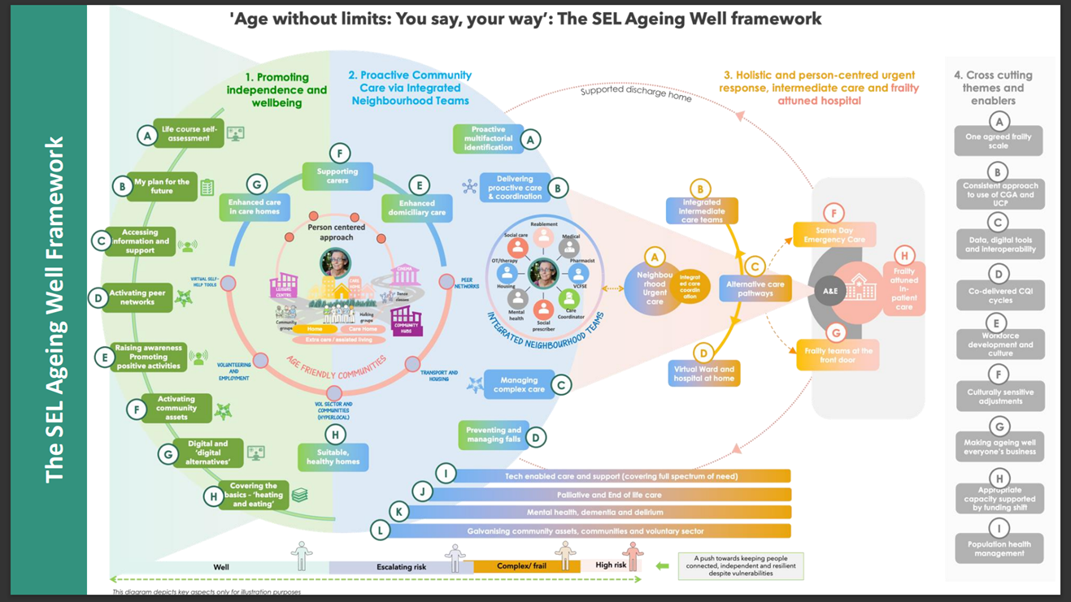
SEL Neighbourhood developments and context

Slide 4
Greenwich Neighbourhood developments
Engagement and co-production – HGP wide
Care model
Design
Jessica Arnold
Workforce
Lisa Wilson
Population health
Sam Bennett
In Greenwich, three interdependent workstreams have
been set up to move this forward, all of which will be
touched upon today, plus key enabler streams →
Progress to date:
Positioning ourselves strongly within SEL
Many conversations with individuals and smaller groups within primary care and system partners, and growing enthusiasm for the need and opportunity
Support from Greenwich LMC to include Proactive Care in the PMS Premium
Working groups now set up for the Population Health and Workforce workstreams
Connecting Greenwich and Public Health-led work in Horn Park, Thamesmead, Plumstead & Glyndon and Blackheath & Charlton
Learning from targeted frailty work by Oxleas/Blackheath Standard, and LTCs focused of Heritage PCN’s Multi-morbidity Models of Care pilot for CKD
Opportunity to build on the existing frailty pathway
Neighbourhood geographies now agreed – bringing Neighbourhoods to life in real places
Neighbourhood Hubs scoping and strategic next steps for estates
Estates
Jessica Arnold
Digital enablement of workforce
Lisa Wilson
Communications
Russell Cartwright

Slide 6
So, what next for Greenwich?
Identify funding – no additional recurrent funding!
Model numbers – balancing target cohort size and system capacity
Consider roll-out approach, e.g. starting small or by geography or by cohort
Secure commitment from all system partners
Engage and empower clinical and operational staff at all levels, including:
Community services teams
Consultants and hospital staff
GP practice staff – and wider primary care
Voluntary sector organisations
Social care and Home Care organisations
Care homes
Approaching public, patient and carer engagement in a meaningful way… and co-designing their future role directly in patient care

Slide 7
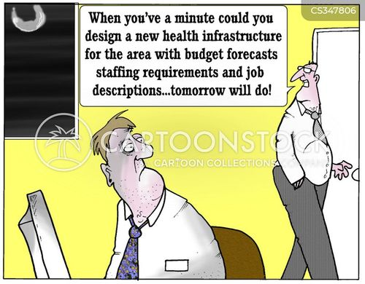
Thank you!
Jessica Arnold, Director of Primary Care and Neighbourhoods
Jessica.Arnold@selondonics.nhs.uk

